Slide 1

Introduction to Legal Frameworks
Guru Srinivasan

Slide 2

Contents
English Legal System basics
Types on businesses
Contracts
Employment law

Slide 3
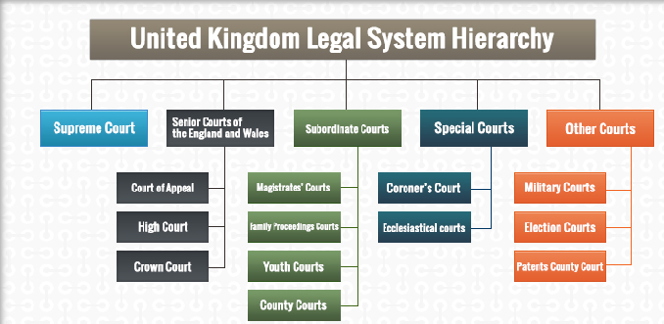
English legal Systems

Slide 4

Court System in England and Wales
Criminal
Court of Appeal
Civil
Crown Court
The High Court
Magistrates Court
County
Court
Criminal Law
Civil Law

Slide 5
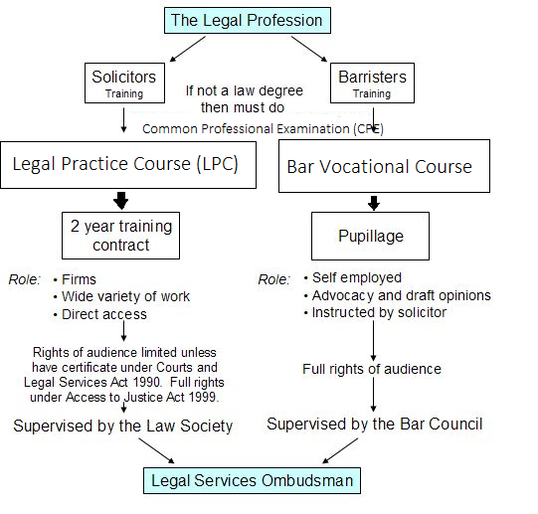
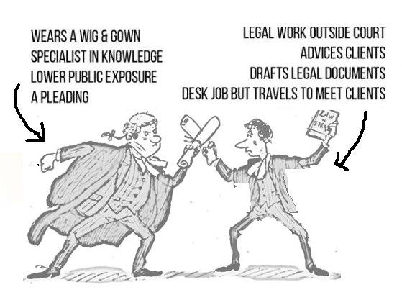
Solicitor vs Barrister
Barrister
Solicitor

Slide 6
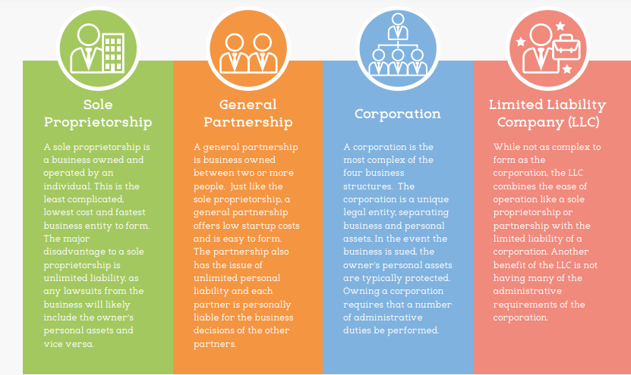
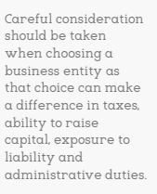
Types of Business Entities
All businesses fall into one of these four entities

Slide 7
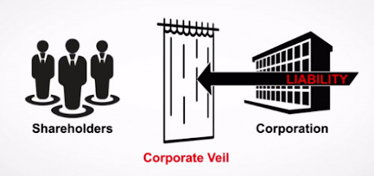
Separate legal personality and the corporate veil
A separate legal entity is a person recognised by law - a "legal person". The entity has its own legal rights and obligations, separate to those running and/or owning the entity.
The company - which is a separate legal entity - insulates the individuals participating in the business from personal liability which may arise as a result of doing business.
That person could be a company, limited liability partnership, or any other entity recognised by law as having its own separate legal existence.

Slide 8
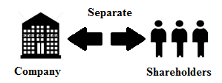
Separate legal entities
The hallmarks of a separate legal entity are that it can:
buy, sell and own property of any kind in its own name
agree to legally binding contracts, and
sue and be sued in its own name.
incur debt (which is created by a contractual relationship)
become creditors, by lending to others
own assets - ie property:
tangible: desks, chairs, pens and paper
intangible: such as intellectual property rights: copyright, designs, trade marks and confidential information
own real property, ie land, and
be liable to pay taxes (a statutory obligation)

Slide 9
Law of Contracts
An agreement giving rise to obligations which are enforced or recognsied by law.
To make it legally binding, should have following elements
An offer
An acceptance after careful understanding without duress
An intention to create legal relationship
A consideration with something of some value
Contract can be in writing, be made orally, be inferred by conduct or formed using a combination of all three
Contracts must be complete provide necessary information for courts to decide in case of disputes

Slide 10
Employment Contracts
Full-time employment
Permanent position
annual salary or hourly wages
paid holiday days
pension benefits
parental leave allowances
Statutory Sick Pay
Most full-time roles are 35+ hours per week but not mandatory.
Part-time employment
Similar to Full-time employment contract but with fewer contracted hours
Benefits and perks depends on contracted hours
Fixed-term or temporary employment
Similar to Full-time employment contract but for certain duration
Benefits and perks depends on contracted duration.

Slide 11
Employment Contracts
Zero contract hours
Employer will ask the employee to work when they are required.
Employer doesn’t have to offer any set amount of hours
Employee doesn’t have to work when the employer wants them to.
Employees on a zero hour contract can look for work and work elsewhere
Employees receive similar entitlements and benefits to a permanent worker
Employer must pay at least the National Minimum Wage
Freelancers or contractors
The freelancer or contractor may receive a contract with a specific start and end date or duration of specific project
Freelancers and contractors are often self-employed
New IR35 regulations cover payee and national insurance
Do not receive the same rights and benefits of permanent employees.
Agency staff
Agency staff contracts are agreed and managed by recruitment agents.
The agency looks after the employees’ rights, whilst the employer pays for the employees National Insurance contributions and Statutory Sick Pay.
Legally after 12 weeks’ of employment in the same role, the agency worker will receive the same rights as permanent employees at the business.

Slide 12
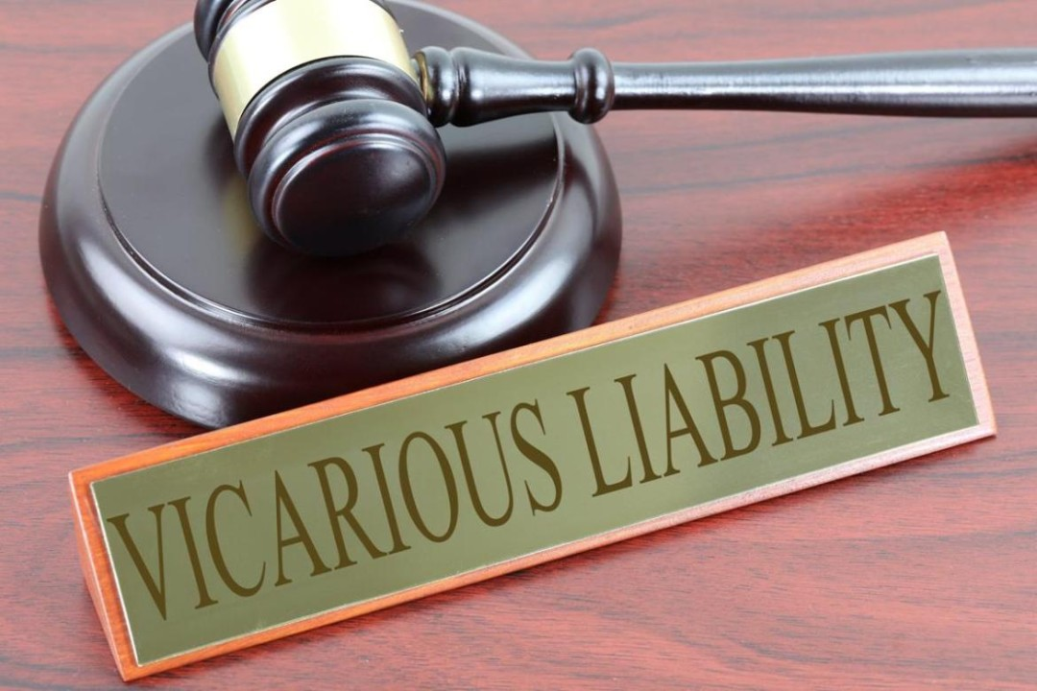
Vicarious liability
Accomplice liability is based on the defendant’s participation in a criminal enterprise and complicity with the criminal actor or principal
Vicarious liability transfers a defendant’s criminal responsibility for the crime to a different defendant because of a special relationship
At early common law, corporations were not criminally prosecutable as separate entities
A corporation can be criminally responsible for conduct apart from its owners, agents, or employees (New York Central R. Co. v. U.S., 2010)
Vicarious liability, transferring criminal responsibility for an offense from an agent or employee of the corporation to the corporation itself, based on the employment relationship.
the agent or employee also is responsible for the crime he or she commits.
A corporation is vicariously liable only if an agent or employee commits a crime during the agent or employee’s scope of employment (720 ILCS, 2010).

Slide 13

Question time

